Slide 1
EEA Grants
Norway Grants
Succeed with Mathematical Games
Nils Kristian Hansen, UiA
4. August 2014

Slide 2
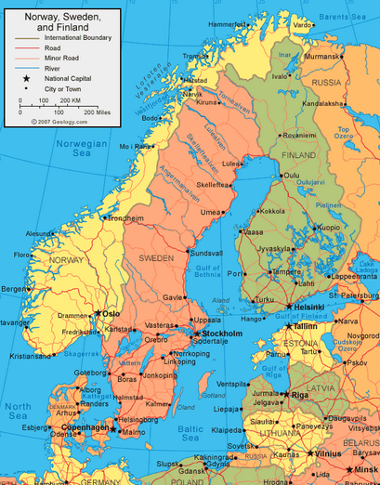
Succeed with Mathematical Games
Me
Assistant Professor at the University of Agder
Main campus, Kristiansand
Teaching experience in ICT and mathematics
Former software developer
Not a gamer
Notes:
Love the American terminology, where we all are professors.
In British technology I am just a «lecturer».

Slide 3
Succeed with Mathematical Games
This workshop
Theory – my contribution:
Using games in mathematics education
Why
How
Practice – your contribution:
Exploring some games
Discussing game properties
Sketching your own mathematical game
I’m sure many of you are gamers
Notes:
You will not listen to me for four hours, but participate in activities. I hope you all have computers or other devices
I initially planned to select games for you, but your first task will be to find games on the net.

Slide 4
Succeed with Mathematical Games
Why video games in maths?
Boy (12) at market sells coconuts at 35 R$ each
Customer:
How much for ten coconuts?
Boy:
Three is $105$, so nine is $105 + 105 + 105 = 315$
Then one more, that makes $315 + 35 = 350$
Used to sell two or three coconuts
Knows the price of these
Uses this knowledge to obtain answer
Notes:
Use the word «video», not «computer», because some games, like Xbox PlayStation and Wii do not run on computers. Video is not about old cassettes, It means «I see» in Latin.
A study was carried out in Brazil, to test the arithmetical capabilities of children.

Slide 5
Succeed with Mathematical Games
Why video games in maths?
Brazilian children solving addition problems:
Real life situation:
98 % correct
Situation as word problem:
“You sell coconuts at 35 R$, how much is ten?”
74 % correct
Problem in symbolic form:
“Calculate $35∙10$”
37 % correct
Subtraction worse, division even worse
0 % on symbolic division problem
Notes:
I’m not sure if it was exactly phrased “35*10”, that’s multiplication. Maybe it was 35 + 35 + 35 + ...

Slide 6
Succeed with Mathematical Games
Why video games in maths?
Learning in real situations = situated learning
Very effective, in line with evolution
How do the French learn English?
Previously: From books, not television or film
Now: From the Internet
Want to be fluent in English?
Go, live in England
Want to be fluent in maths?
Go, live in math-country
Does not exist, unfortunately
Notes:
The French and Germans dub films, not the Scandinavians. Imagine Elvis singing in German! Do you dub films in Slovenia / Bulgaria

Slide 7
Succeed with Mathematical Games
Why video games in maths?
Video game may provide
Real life environment
Problem based approach
Structure for learning
Incentive to keep playing / learning
Pleasurable and stimulating environment
Familiar to “everyone”
97 % of US children play video games
Video games are grossly engaging

Slide 8
Succeed with Mathematical Games
A closer look at video games
Video games have been with us since
1962
1972
1982
1992
What do you think?
Go to www.govote.at
Enter code 63 96 06
Vote!
Notes:
www.govote.at will be used in later votes, but the code will change
The vote is created with “Mentimeter”, with a free basic version, but pro versions are a 100 dollars a month
Show results.
Getting it wrong is not a defeat, but an opertunity to learn.
You were not allowed to see the results while voting, as that would influence your answer. You would in fact learn from the others.
I was curious, beacuse for many of you 1992 is the “good old days”.

Slide 9
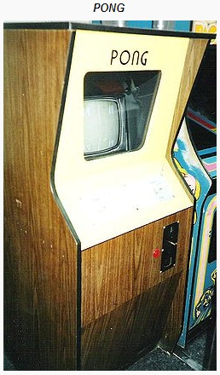
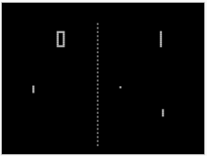
Succeed with Mathematical Games
A closer look at video games
Early games
1972: Pong arcade game
1975: Pong home edition (by Atari)
Used a television set as a screen

Slide 10
Succeed with Mathematical Games
A closer look at video games
Modern games
2004: World of Warcraft (WoW)
Massively multiplayer online role-playing game (MMORPG)

Slide 11
Succeed with Mathematical Games
A closer look at video games
Genres
Board games
May be electronic versions of ordinary games, chess, backgammon, …
Skill games
Tetris, Super Mario
Trains hand-eye coordination
Simulation games
Golf, ski, car, flight
Strategy games
Civilization, Sims
Build and maintain a society
Notes:
Mainly based on a Norwegian online dictionary, other genres exist. If you go to Wikipedia, you will find many more, including sub genres. But I want to keep these genres as a basis for later work.

Slide 12
Succeed with Mathematical Games
A closer look at video games
Genres
Role playing games
World of Warcraft
Take on the role of a fictional character
Action games
Grand Theft Auto
First person shooters
Often violent
Pedagogical games
Pedagogical purpose essential and obvious
Many belong to several genres

Slide 13
Succeed with Mathematical Games
A closer look at video games
World of Warcraft is a MMORPG
More general term: MMOG (MMO)
Massively Multiplayer Online Game
Users may cooperate
Form learning communities
Users may compete

Slide 14
Succeed with Mathematical Games
A closer look at maths
About manipulating symbols?
Impossible to implement in games?
Needed for precision and advanced maths
Not necessary for “everyday maths”
Notes:
Symbols provide an exact, unambiguous language needed for maths

Slide 15
Succeed with Mathematical Games
A closer look at maths
Maths tends to throw people off
“This is math = I can’t do it”
Advanced maths requires interest and skills
Almost everybody can learn everyday maths
Only 3 % has dyscalculia

Slide 16
Succeed with Mathematical Games
A closer look at maths
Everyday maths
A dress costs € 200
Price goes up 15 %, later down 15 %
Price is now
Lower than before
€ 200 as before
Higher than before
Go to www.govote.at
Enter code 96 03 45
Vote!

Slide 17
Succeed with Mathematical Games
A closer look at maths
Everyday maths
Price goes up 15 % from € 200:
Price is now $€ 200+$ $€ 200∙\frac{15}{100}=€ 230$
Price goes down 15 % from € 230:
Price is now $€ 230−$ $€ 230∙\frac{15}{100}=€ 195,50$
Notes:
The increase is 15 % of 200, but the decrease is 15 % of 230, therefore the decrease is larger.

Slide 18
Succeed with Mathematical Games
A closer look at maths
Everyday maths
Childbirth: chances of boy 50 %, girl 50 %
Chances that 2-child family has 1 boy & 1 girl are
$0 \%$
$25 \%$
$33\frac{1}{3} \%$
$50 \%$
$100 \%$
Go to www.govote.at
Enter code 52 04 85
Vote!
50 %
50 %
? %
Notes:
0 % would mean that no 2-child families have one boy and a girl, and 100 % that all 2-child families have one boy and a girl, and you know that this is not the case. Answers like these appear when someone does the math (incorrectly) as a separate process without thinking of what the maths represent.

Slide 19
Succeed with Mathematical Games
A closer look at maths
Everyday maths
First child | Second child | Chances
BOY | BOY | 25 %
GIRL | GIRL | 25 %
BOY | GIRL | 25 %
GIRL | BOY | 25 %

Slide 20
Succeed with Mathematical Games
A closer look at maths
Subjects
Arithmetic
Calculate
$2+3$
$\frac{1}{2}+\frac{1}{3}$
$3^{5}+\sqrt{3}$
$\ln{5}$
Number theory
A number is divisible by 3 if its digit sum is divisible by 3
Notes:
I’ll give an overview of the most common subjects taught in school. I may have forgotten something.
Arithmetic is about manipulating numbers. Not only whole numbers, but also fractions, powers, roots and logarithms
Number theory is more demanding, about rules concerning numbers

Slide 21
Succeed with Mathematical Games
A closer look at maths
Subjects
Algebra
Simplify $3{(x}^{2}+4x)−2\left(x−x^{2}\right)$
$5x^{2}+10x$
Obtain a formula for solving $ax^{2}+bx+c=0$
$x_{1,2}=\frac{−b±\sqrt{b^{2}−4ac}}{2a}$
Actually employing the formula is arithmetic
Notes:
We’re not manipulating numbers any more, but structures that apply to all numbers

Slide 22
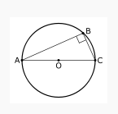
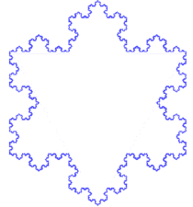
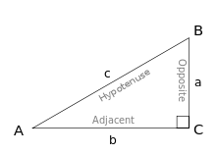
Succeed with Mathematical Games
A closer look at maths
Subjects
Geometry
Euclidian Geometry
Trigonometry
Fractals

Slide 23
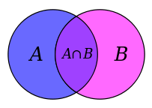
Succeed with Mathematical Games
A closer look at maths
Subjects
Logic
If x = TRUE and y = FALSE, then
x OR y is
TRUE
x AND y is
FALSE
Set theory

Slide 24
Succeed with Mathematical Games
A closer look at maths
Subjects
Combinatorics
In how many ways can you order three objects
$6$
How many bridge hands with 8 hearts are there?
$740 999 259$
Probability theory
What is the probability of obtaining when throwing a die twice?
$\frac{11}{36}$
Notes:
For simplicity I don’t show you how I obtain the result, if you are interested, we can do the calculations during the break

Slide 25
Succeed with Mathematical Games
A closer look at maths
Subjects
Statistics
8 pupils weigh 32, 35, 33, 30, 28, 29, 35 and 27 kg. Calculate average, standard deviation, median and mode
31,1 2,9 31, 35

Slide 26
Succeed with Mathematical Games
A closer look at maths
Subjects
Calculus
Calculate the derivative of $x^{2}+3x$
$2x$
Solve the integral $\int{\cos{x dx}}$
$\sin{x}+C$
Find the asymptotes of the function $f\left(x\right)=\frac{2x+3}{x−1}$
$$x=1,y=2$$

Slide 27
Succeed with Mathematical Games
A closer look at maths
Which subject?
The task “Calculate $5x^{2}+10x$when $x=−2$” is
Algebra
Arithmetic
Calculus
Combinatorics / probability theory
Geometry
Logic / set theory
Number theory
Statistics
Go to www.govote.at
Enter code 88 67 73
Vote!
Notes:
I’m not asking you to do the calculation, the answer is 0.
I included all the categories as a summary / reminder. Most of them are obviously wrong. It may resemble calculus, but there is no function, so ... It is not algebra, since we are manipulating numbers, not symbols.

Slide 28
Succeed with Mathematical Games
What is mathematics
No precise definition
A duality
A way of thinking about problems and issues
Basic skills
Which is more important?
Neither
But basic skills may get you on your way
Can video games teach basic skills?
Easily
Can video games teach ways of thinking?
With more effort
Architecture
Bricklaying / carpentry
Notes:
Now that we’ve had a look at the subjects, it’s easy to define what mathematics is?
Example: Basic skill = learning long division. Way of thinking: How do long division reflect the principles of our number system

Slide 29
Succeed with Mathematical Games
Learning maths without knowing it?
Video games are fun
Learning maths is boring
Many think maths is difficult because it is maths
Can you learn maths without thinking of it as maths?
Yes, if the education is
An integral part of the game
E.g. Buying cloth for a costume
Requires doing geometry to calculate the amount of cloth
Not something superimposed
E.g. An equation pops up and must be solved to continue
NOT !
Notes:
We know that learning maths is not boring, but many think it is.

Slide 30
Succeed with Mathematical Games
Group work: Analyze a game
Go to www.mathplayground.com
Or an other resource site of your choice
Choose a game you find amusing and educational
As far up on the following scales as possible
Role playing / adventure
Multi user
Math hidden
Ways of thinking
Board / skill game
Single user
Math obvious
Basic skills
Notes:
I’m afraid it is difficult to find games that are at top of the scales

Slide 31
Succeed with Mathematical Games
Group work: Analyze a game
www.mathplayground.com / other resource
State:
Why you like the game
What math subject(s) it teaches
Rate:
Board / skill  Role playing / adventure
Single user  Multi user
Math obvious  Math hidden
Basic skills  Ways of thinking

Slide 32
Succeed with Mathematical Games
A math game: Dragonbox
“Secretly teaches children maths”
Notes:
Show 1.1 – 1.4, 1.9, 1.12, 1.15 – 1.16, 1.20, 2.1, 2.11, 2.20, 3.11, 3.20

Slide 33
Succeed with Mathematical Games
Mathematics teaching
Early days
Computational skills
Procedural fluency
Learning methods, but not understanding
1950 – 1960, “New Math”
Intention and idea good
Turned out as conceptual understanding only
“Back to basic” movement
2001 National Research Council (US) report
Introduces five elements of mathematical proficiency
Notes:
New Math was intended to address both conceptual understanding and computational skills. New math, I quote a US source.
New Math: Doesn’t matter if the answer is wrong if the method is right. Imagine an engineer constructing a bridge by this principle.

Slide 34
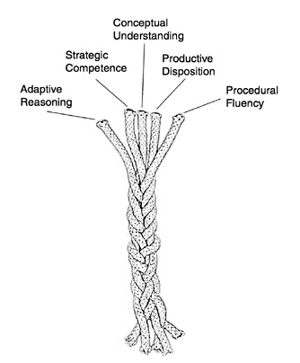
Succeed with Mathematical Games
Mathematical proficiency
The five elements:
Conceptual understanding
Procedural fluency
Strategic competence
Adaptive reasoning
Productive disposition
Source: Devlin
Notes:
We’ll have a closer look at the elements in a moment, and see how they can be implemented in a computer game.
I’ve stolen the image from this book, which is my main source. I’ll put it here if you want to have a look at it, and it is also in the literature list in the last slide. You see the symbolism? Each strand is weak by itselft, but toghether they form a solid rope.

Slide 35
Succeed with Mathematical Games
Mathematical proficiency
through video games
Conceptual understanding
Understanding concepts, not just methods
Easier to learn new facts
Remember things better
Difficult to obtain in video games
Procedural fluency
Master basic calculation algorithms
Addition, multiplication, division ...
Obtained through repetition
Easy to implement in video games
Maybe not all needed in calculator age
But may lead to

Slide 36
Succeed with Mathematical Games
Mathematical proficiency
through video games
Strategic competence
Ability to use math to solve real world problems
“You’re having a party.
You estimate that each guest eats ¼ pizza
How many pizzas required for 12 guests?”
Elegantly obtained by player solving real world problems in video games
Adaptive reasoning
Ability to do step by step reasoning
Ability to follow formal proofs
Difficult to obtain in game not explicitly mathematical

Slide 37
Succeed with Mathematical Games
Mathematical proficiency
through video games
Productive disposition
Ability to see sense in mathematics
To see mathematics as useful
Believe that learning mathematics pays off
Obtained in video game if doing math is integrated and essential to succeed

Slide 38
Succeed with Mathematical Games
Conceptual understanding
through video games
Difficult to achieve in game
Step back from activities and reflect
Read a text
See a video
Go to a web site
Players accept it if it advances game

Slide 39
Succeed with Mathematical Games
Conceptual understanding
through video games
Example: Two numbers must be combined to open a treasure chest
3 and 5 is given
By trial and error player obtains 15
4 and 6 is given
Player tries 24
It is wrong
By trial and error player obtains 12
6 and 15 is given
Player tries 90
It is wrong
Player tries 45
It is wrong
By trial and error player obtains 30
Notes:
What do you think the player tries when 4 and 6 is given? It would be natural to assume it is the product, 24, since that was the case the last time. Next time the player tries the product, than half the product, since that appears to have been correct the last time.

Slide 40
Succeed with Mathematical Games
Conceptual understanding
through video games
3 and 5  15, 4 and 6  12, 6 and 15  30
5 and 15  ?
Pirates are coming, no time for trial and error
There must be a quick way, a pattern ...
What is the correct answer?
Go to www.govote.at
Enter code 522 27
Vote!
The answer is 15
Pattern is “least common multiple” (lcm)
Step back and reflect
What is the concept of least common multiple?
How do we find it?
Notes:
What do you think 5 and 15 combines to? This time we have an open ended alternative. LCM is the lowest number that is divisible by both elements.

Slide 41
Succeed with Mathematical Games
Elements of successful math game
Play on team with evolution
People want their character to succeed
Mathematical proficiency should be natural to achieve
Must be necessary to proceed in game
Learning by doing
Self paced learning
Learning by exploration
Immediate use of knowledge
Regular tests of obtained knowledge
Notes:
In fact success criteria applies to all games.
Tests do not mean written tests, but that you have to show in practice what you have learned.

Slide 42
Succeed with Mathematical Games
Elements of successful math game
Attractive and useful to different types of players
Problem solvers
Wants to succeed with tasks
Explorers
Want to discover as much as possible
Competitors
Want to compete and gain power over others
Socializers
Want to socialize with other players
Not really playing game

Slide 43
Succeed with Mathematical Games
Group work: Sketch a game
Outline a mathematical game
State
What mathematical subject does it teach?
Which element(s) of mathematical proficiency is exercised?
Which kind of players does it appeal to? Why?
For reference, open this presentation at Slideshare
Go to www.slideshare.net
Search for “ALICT 2014”
Notes:
Quickly summarize what’s at each point

Slide 44
Succeed with Mathematical Games
Video game = teacher unemployed?
No!
Game must be a supplement to existing methods
Skills from game world not automatically transferable to real world
Skills from game world not necessarily general enough
Misconceptions may occur
Notes:
Quickly summarize what’s at each point

Slide 45
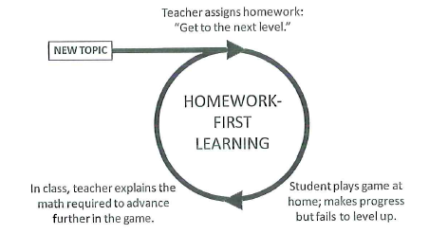
Succeed with Mathematical Games
Video game = teacher unemployed?
Source: Devlin
Notes:
Quickly summarize what’s at each point

Slide 46
Succeed with Mathematical Games
Literature
Devlin, Keith: Mathematical Education for a New Era. AK Peters, Ltd, 2011. ISBN 978-1-56881-431-5
Young, Michael F. & al: Our Princess Is in Another Castle. A Review of Trends in Serious Gaming for Education. Review of educational research. March 2012 vol. 82 no. 1 61-89
Class material by Cornelia Brodahl
Class material by Nils Kristian Hansen
Notes:
Quickly summarize what’s at each point

