Slide 1
Exploring the Effect of Teaching Methods on Students’ Learning of School Informatics
Said Hadjerrouit
University of Agder
Kristiansand, Norway
Said.Hadjerrouit@uia.no
InSITE 2015:
Informing Science + IT Education Conferences
June 29 - July 5 2015,
Tampa, Florida, United States

Slide 2
Current State of School Informatics
Informatics subject
More difficult to teach than traditional subjects
Lacks an extensive research base of teaching materials like the one in mathematics education
New National Curriculum
Emphasis on a set of well-defined informatics topics
Does not provide clear information on teaching methods
Little research on teaching methods and their effect on learning
Need for research to gain knowledge on how informatics should be taught to achieve learning goals

Slide 3
Research Goal
The main research goal is to answer the following question:
Which teaching methods do students find most helpful in learning school informatics?

Slide 4
Teaching Methods
Teaching with blackboard/overhead projector
Demonstration of software tools
Solving software exercises with teacher assistance
Project work over several days or weeks
Group work under the guidance of the teacher
Individual problem solving
Homework assignments and ask friends, siblings, or parents for help
Reading textbooks and user manuals
Using study material made online by the teacher
Present solutions to problems in front of the class

Slide 5
Categorization
Teaching methods and learning theories
Formal and informal teaching methods
Type of interactions involved in teaching methods
Teaching methods and the Learning pyramid

Slide 6
Teaching Methods and Learning Theories
Behaviorist learning:
Classroom teaching with blackboard /overhead projector.
Demonstrations of software tools
Constructivist learning:
Solving software exercises with teacher assistance
Individual problem solving
Reading textbooks and user manuals
Using study material made online by the teacher
Sociocultural learning:
Project work over several weeks
Group work
Homework assignments and ask friends, siblings and / or parents for help
Student presentation in front of the class

Slide 7
Formal and Informal Methods
FORMAL METHODS | BOTH FORMAL AND INFORMAL METHODS | INFORMAL METHODS
Teaching with blackboard/overhead projector | Project work over several days or weeks | Individual problem solving
Demonstration of software tools | Using study material made online by the teacher | Homework assignments and ask friends, siblings or parents for help
Solving software exercises with teacher assistance |  | 8. Reading textbooks and user manuals
Group work under the guidance of the teacher |  | 10. Present solutions to problems in front of the class

Slide 8
Methods and Interactions
INTERACTION | TEACHING METHODS
Teacher – student | 1. Teaching with blackboard/overhead projector 2. Demonstration of software tools
Student – student | 4. Project work over several days or weeks 5. Group work under the guidance of the teacher Present solutions to problems in front of the class
Student – textbooks | Reading textbooks and user manuals
Student – friends/ parents/ siblings | 7. Homework assignments and ask friends, siblings or parents for help
Student – Internet | 9. Using study material made online by the teacher
Student – software tools | 3. Solving software exercises with teacher assistance 6. Individual problem solving

Slide 9
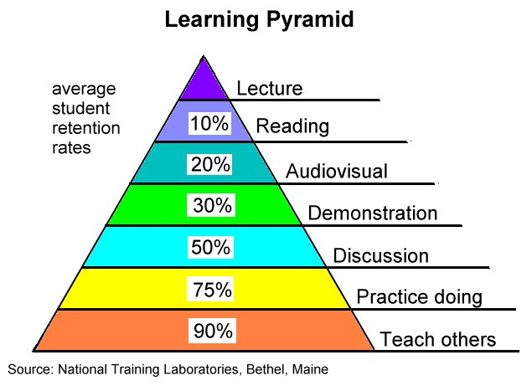
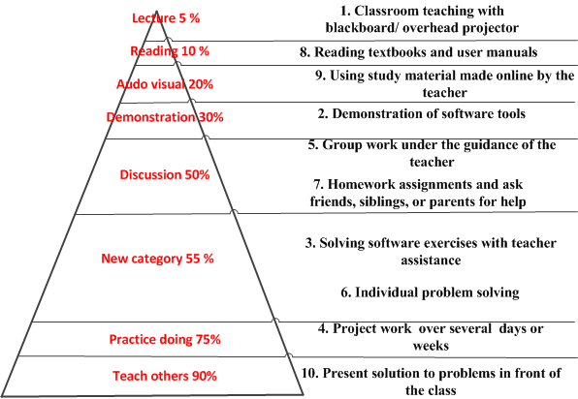
Learning Pyramid

Slide 10
Research Design
Methods
Survey questionnaire
Open-ended questions
Trainee teachers’ reports
Observations of trainee teachers’ activities during their teaching practice
Participants
2 trainee teachers with 2 different classes, class 1 and class 2
40 school students (class 1=15, class 2=25)
Teaching tasks
Mostly database design using Dreamweaver and MySQL

Slide 11
Synthesis of Results
 | Class 1: MEAN | Class 1: RANK | Class 2: MEAN | Class 2: RANK | Class 1 & 2: MEAN | Class 1 & 2: RANK
1. Teaching with blackboard/overhead projector | 3.82 | 3/4 | 3.68 | 6 | 3.75 | 4
2. Demonstration of software tools | 4,00 | 2 | 3.72 | 4/5 | 3.86 | 3
3. Solving software exercises with teacher assistance | 4.09 | 1 | 3.84 | 2 | 3.96 | 2
4. Project work over several days or weeks | 3.82 | 3/4 | 4.28 | 1 | 4.05 | 1
5. Group work under the guidance of the teacher | 3.27 | 7 | 3.64 | 7 | 3.45 | 7
6. Individual problem solving | 3.45 | 6 | 3.72 | 4/5 | 3.58 | 6
7. Homework assignments, and ask friends, siblings, or parents for help | 1.91 | 10 | 3.12 | 10 | 2.51 | 10
8. Reading textbooks and user manuals | 3.55 | 5 | 3.76 | 3 | 3.65 | 5
9. Using study material made online by the teacher | 2.82 | 9 | 3.6 | 8 | 3.21 | 8
10. Present solutions to problems in front of the class | 3.09 | 8 | 3.2 | 9 | 3.14 | 9

Slide 12
1. Project Work
Highly relevant method to 31 students
In line with the Learning pyramid
Promotes social-cultural learning, social interactions, formal and informal ways of learning
Project work is followed by presenting the final product in front of the class
Some students were not confident in the presentation part of the project
Important to be prepared for a workplace where team work and group dynamics are often crucial parts of the work content

Slide 13
2. Solving Software Exercises with Teacher Assistance
31 students liked this method
Supports constructivist learning, and formal ways of learning
Teacher plays an important role in providing help
Method will be an important part of students’ future professional career
In line with the spirit of the subject as a practical subject

Slide 14
3. Demonstration of Software Tools
28 students liked this method
Behaviorist and formal method in which the interaction is mainly between teacher and students
Not quite in line with the Learning pyramid, but when it comes to instruct students to learn software functionalities, the method is highly relevant
Highly dependent on competent teachers, otherwise students will probably remain passive

Slide 15
4. Teaching with Blackboard/Overhead Projector
Seems to be relatively important, in stark contrast to the Learning pyramid
25 students liked the method, even though it is behavioristic, formal, and teacher-directed
Highly dependent on the teacher and the quality of information provided

Slide 16
5. Reading Textbooks and User Manuals
27 students were satisfied with this method
Seems to be important, in contrast to the Learning pyramid
Informal method that supports students’ interactions with textbooks, and constructivist learning
Learning effect depends on the quality of the textbooks provided and other material made available

Slide 17
6. Individual Problem Solving
Refers to students who are supposed to learn by themselves
“Only” 24 students liked this informal method that supports constructivist learning
Does not automatically work by itself, without teacher help, because of the complexity of software, or programming tasks

Slide 18
7. Group Work under the Guidance of the Teacher
21 students agreed that they liked this method
In some contrast to the Learning pyramid
Fosters student-student interactions and socio-cultural learning similar to project work
Unless group work is linked to project work, it will not have the desired learning effect
Just discussing theoretical issues will not attract and motivate students

Slide 19
8. Using Study Material Made Online by the Teacher
Only 21 students liked the method
Informatics is a practical subject
It is not appropriate to put a lot of theoretical material on the Web
Unless the method is directly aimed at practical tasks, eventually Web-based, online material has little learning effect

Slide 20
9. Present Solutions to Problems in Front of the Class
Only 18 students liked this method, which is supposed to foster informal and socio-cultural learning
Many students did not like presenting their work to the class, even though the method has 90% learning effect
Requires confidence and trust to be able to present solutions in front of the students
Some students were not confident in presenting the final product of their project

Slide 21
10. Homework Assignments and Ask Friends, Siblings, or Parents for Help
10 students were satisfied with this method, which is supposed to foster socio-cultural learning
Unrealistic for most students to expect that they can get help by friends, siblings, or parents
Informatics uses specialized applications based on relatively complex logic
“Ordinary people" have little chance to help students
Even software people must have been involved in the specific tasks to be of greater help

Slide 22
Summary of Results
Project work seems to be the most preferred method
Students doing exercises and being instructed by teachers, make better progress than those who are expected to learn entirely by themselves (individual learning)
The results confirm the importance of teacher-directed instruction
Good textbooks and study material still important
Demonstrations of software tools are still useful
Emphasis on constructivist learning (individual learning without teacher guidance) is not supported by this work

Slide 23
Conclusions
Small sample with a limited source material
Few similar research studies
Importance of teaching informatics using various methods
Importance of connecting teaching methods to learning theories and didactical concepts
More research studies are needed to build a base of materials like the one in mathematics education

